Slide 1
Computer Organisation
Topic 4
Digital Logic (Part 1)
Stallings, Computer Organization & Architecture (9th Ed.), Chap. 11

Slide 2
Learning Objectives
Understand the basic operations of Boolean algebra.
Distinguish among the different types of flip-flops.
Use a Karnaugh map to simplify a Boolean expression.
Present an overview of programmable logic devices.

Slide 3
Outline
Boolean Algebra
Gates
Combinational Circuits
Implementation of Boolean Functions
Multiplexers
Decoders
Read-Only Memory
Adders
Notes:
Gates are the physical implementation of Boolean algebra

Slide 4
Introduction
The operation of the digital computer is based on the storage and processing of binary data.
How these are implemented using combinational & sequential circuit
Combinational and sequential circuits, which are constructed from gates
Notes:
As an introduction, the computer does a lot of operations based on what its stored.
A lot of things happening inside the computer are storage in nature and everything is done in binary format.
How being all of these implemented? In a way of combining various circuit in order to perform functions, and later in the second part of this topic, you will learn the sequential circuit to perform some other most sophisticated functions.

Slide 5
Introduction
Boolean Algebra
Introduced in 1854 by George Boole, only used in circuit design in 1938
Mathematical foundation of digital circuits
A tool to:
Analysis: It is an economical way of describing the function of digital circuitry.
Design: Given a desired function, Boolean algebra can be applied to develop a simplified implementation of that function
Notes:
The digital circuitry in digital computers and other digital systems is designed, and its behavior is analyzed, with the use of a mathematical discipline known as Boolean algebra.
As with any algebra, Boolean algebra makes use of variables and operations. In this case, the variables and operations are logical variables and operations. Thus, a variable may take on the value 1 (TRUE) or 0 (FALSE). The basic logical operations are AND, OR, and NOT, which are symbolically represented by dot, plus sign, and overbar:

Slide 6
Boolean Algebra
Use logical variables and operations
Variable takes the value of 1 (TRUE) or 0 (FALSE)
1 | 0
High voltage | Low voltage
On | Off
True | False

Slide 7
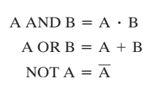
Boolean Algebra
Basic logical operations – AND, OR, and NOT
represented as dot, plus sign and overbar

Slide 8

Basic Operations
AND
OR
NOT
True if both operands are TRUE
True if either operands is TRUE
Inverts its operand
.
-
+
AND
AND
AND
D = 1 if A is 1 or if both B =0 and C = 1
Otherwise, D = 0.

Slide 9

Other Operations
XOR
NAND
NOR
True if and only if exactly one operand has value 1
Complement (NOT) of the AND function
Complement (NOT) of the OR function

Slide 10
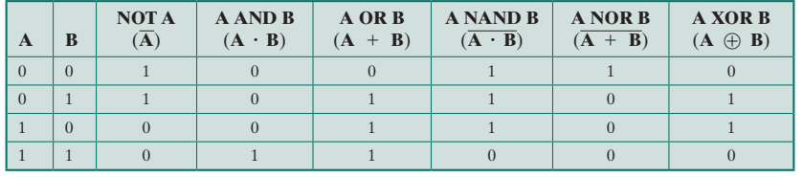
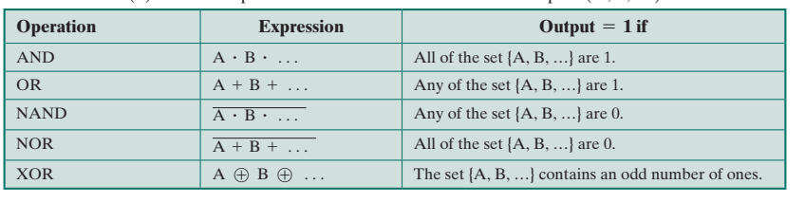
Truth Table
The resulting value of the operations for all possible values of the operands

Slide 11
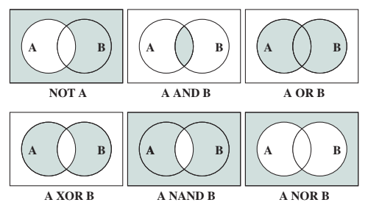
Boolean variables in circles

Slide 12
Basic Identities
 | AND | OR
Commutative Laws | A.B = B.A | A + B = B + A
Idempotent Laws | AA = A | A+A = A
Distributive Laws | A.(B + C) = (A.B) + (A.C) | A(B.C) = (A + B) . (A + C)
Identity Laws | A.1 = A | A + 0 = A
Associative Laws | A.(B.C) = (A.B).C | A + (B + C) = (A + B) + C
Inverse Elements | A.A = 0 | A +A = 1
DeMorgan’s Theorems | A.B = A + B | A + B = A.B
Notes:
Commutative law states that changing the sequence of the variables does not affect the output of a logic circuit.
The idempotent law states that when you operate on a variable with itself, the result is that same variable.
Distributive Laws states that if we multiply a number by a group of numbers that are added/subtracted, it will generate the same result if we do each multiplication separately.
Identity laws states, for 1 AND A, the product of 1 and any number of variable is the number or variable itself
for 0 OR A, the sum of 0 and any number or variables is the number of variable itself
To remember the identity law easily – AND with 1 doesn’t change anything | OR with 0 doesn’t change anything as well
Think of 1 as "true" and 0 as "false":
OR with true (1) is always true
AND with false (0) is always false
Associative laws states that grouping of operands doesn't affect the result of the operations.
Inverse Laws is the unique law of Boolean algebra this law states that, the complement of the complement of any number is the number itself.
DeMorgan states the complement of the product of the variables is equal to the sum of their individual complements of a variable

Slide 13
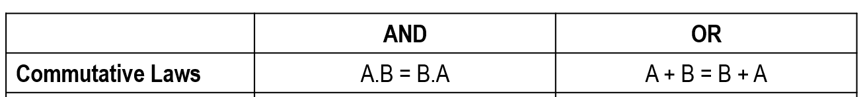
Basic Identities (Examples)
1 × 0 = 0 × 1 = 0
1 + 0 = 0 + 1 = 1
1.1 = 1
1 + 1 = 1
1.(0+1) = (1.0) + (1.1)
1(1) = 0 + 1
1 = 1
1(1.1) = (1+1) + (1+1)
1 = 1 + 1
1 = 1
1.1 = 1
1+1 = 1
Notes:
Commutative law states that changing the sequence of the variables does not have any effect on the output of a logic circuit.
Distributive Laws states that if we multiply a number by a group of numbers that are added/subtracted together, then it will generate the same result if we do each multiplication separately.
Identity laws states, for 1 AND A, the product of 1 and any number of variable is the number or variable itself
for 0 OR A, the sum of 0 and any number or variables is the number of variable itself
Associative laws states that the order in which the logic operations are performed is irrelevant as their effect is the same
Inverse Laws is the unique law of Boolean algebra this law states that, the complement of the complement of any number is the number itself.
DeMorgan states the complement of the product of the variables is equal to the sum of their individual complements of a variable

Slide 14
Basic Identities (Examples)
AND
OR
1 × (0 × 1) = (1 × 0) × 1 = 0
1 + (0 + 1) = (1 + 0) + 1 = 1
(1 × 0)' = 1' + 0' = 0 + 1 = 1
(1 + 0)' = 1' × 0' = 0 × 1 = 0
Notes:
Commutative law states that changing the sequence of the variables does not have any effect on the output of a logic circuit.
Distributive Laws states that if we multiply a number by a group of numbers that are added/subtracted together, then it will generate the same result if we do each multiplication separately.
Identity laws states, for 1 AND A, the product of 1 and any number of variable is the number or variable itself
for 0 OR A, the sum of 0 and any number or variables is the number of variable itself
Associative laws states that the order in which the logic operations are performed is irrelevant as their effect is the same
Inverse Laws is the unique law of Boolean algebra this law states that, the complement of the complement of any number is the number itself.
DeMorgan states the complement of the product of the variables is equal to the sum of their individual complements of a variable

Slide 15
Simplifying expressions #1
F = A + BA
BA = A + B
F = A + BA = A + A + B
A + A = 1
F = 1 + B
1 + B = 1
F = 1

Slide 16
Simplifying expressions #2
 | AND | OR
Commutative Laws | A.B = B.A | A + B = B + A
Simplify (X + Y) (Y + Z) (Y + X)
(Y + X) (Y + Z) (Y + X)
1. Re-arrange the expression
(Y + X) (Y + Z) (Y + X)
2. Eliminate the repetitive expressions
(Y + X) (Y + Z)
3. Simplify the expressions

Slide 17
Simplifying expressions #3
 | AND | OR
Commutative Laws | A.B = B.A | A + B = B + A
Simplify the following expressions according to the commutative law:
(A + D) (D + A) (B + E + A)(A + E + B)(A + B + C)
(A + D) (D + A) (B + E + A)(A + E + B)(A + B + C)
(A + D) (B + E + A)(A + B + C)

Slide 18
Simplifying expressions #4
 | AND | OR
Commutative Laws | A.B = B.A | A + B = B + A
Simplify the following expressions according to the commutative law:
(A + B + C)(D + E + F)(X + Y)(C + A + B)
(A + B + C)(D + E + F)(X + Y)(C + A + B) = (A + B + C)(D + E + F)(X + Y) (A + B + C)
(A + B + C)(D + E + F)(X + Y) (A + B + C)
(A + B + C)(D + E + F)(X + Y)

Slide 19
Simplifying expressions #4
 | AND | OR
Commutative Laws | A.B = B.A | A + B = B + A
Simplify the following expressions according to the commutative law:
(ABC) + (A'B'C') + (B'C') + A(B+C) + (CBA) + (C'B')
(ABC) + (A'B'C') + (B'C') + A(B+C) + (ABC) + (C'B')
(ABC) + (A'B'C') + (B'C') + A(B+C) + (C'B')
(ABC) + (A'B'C') + (B'C') + A(B+C) + (B’C')
(ABC) + (A'B'C') + (B'C') + A(B+C)

Slide 20
Simplifying expressions #5
Simplify A = MNOP using DeMorgan’s Theorem
A = M + N + O + P

Slide 21
Simplifying expressions #6
A’B’C’ + AB’C’ + ABC’ + A’B’C + AB’C + ABC
B’C’(A’+A) + AB (C’+C) + A’B’C + AB’C
B’C’(A’+A) + AB (C’+C) + B’C (A’+A)
B’C’(1) + AB (1) + B’C (1)
B’C’+ AB+ B’C
B’(C’+C)+ AB
B’(1)+ AB
B’+ AB

Slide 22
Simplifying expressions #6
A’BC + AB’C’ + A’B’C’ + AB’C + A’BC’
A’BC + AB’C’ + A’B’C’ + AB’C + A’BC’
A’B(C+C’) + AB’(C’+C) + B’C’(A’+A)
A’B(1) + AB’(1) + B’C’(1)
A’B + AB’ + B’C’

Slide 23
Quick Activity #1
A’BC +AB’C’ + A’B’C’ + AB’C + A’BC’
A’B’C’ + A’B’C +A’BC + A’BC’ + ABC + AB’C +AB’C’ + A’BC
A + B’A’
A’B’C’ + A’B’C’ + ABC’ + A’B’C + AB’C + ABC

Slide 24
Quick Activity #1
A’BC +AB’C’ + A’B’C’ + AB’C + A’BC’
A’BC +AB’C’ + A’B’C’ + AB’C + A’BC’
A’B(C+C’) + B’C’(A+A’) + AB’(C’+C)
A’B + B’C’ + AB’

Slide 25
Quick Activity #1
A’B’C’ + A’B’C +A’BC + A’BC’ + ABC + AB’C +AB’C’ + A’BC
A’B’C’ + A’B’C +A’BC + A’BC’ + ABC + AB’C +AB’C’
A’B’(C’+C) + B’C’(A’+A) + A’BC + A’BC’ + ABC + AB’C
A’B’(C’+C) + B’C’(A’+A) + A’B (C+C’) + AC (B+B’)
A’B’ + B’C’ + A’B + AC

Slide 26
Outline
Boolean Algebra
Gates
Combinational Circuits
Implementation of Boolean Functions
Multiplexers
Decoders
Read-Only Memory
Adders
Notes:
Boolean Algebra is the mathematical side of the digital logic
The hardware side is expressed in a form of gate.

Slide 27
Gates
The fundamental building block of all digital logic circuits is the gate.
Logical functions are implemented by the interconnection of gates.
A gate is an electronic circuit that produces an output signal that is a simple Boolean operation on its input signals
The basic gates used in digital logic are AND, OR, NOT, NAND, NOR, and XOR
One or two inputs and one output
Notes:
All these Boolean operation will be expressed in a form of circuits and that is where all the gates are coming
Gates form all these circuit that expresses the Boolean operation.
Only one output because we want to know the true or false of the operation

Slide 28
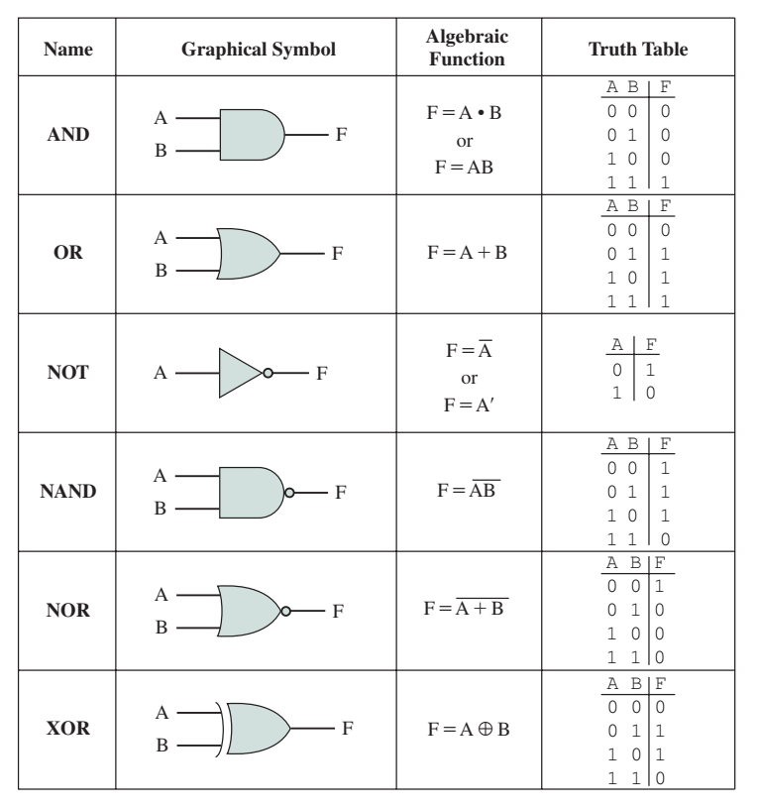
Gates
Graphic symbol, algebraic notation, and truth table

Slide 29
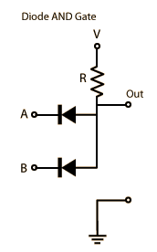
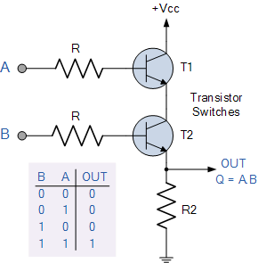
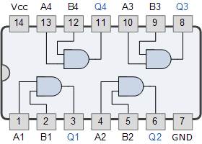
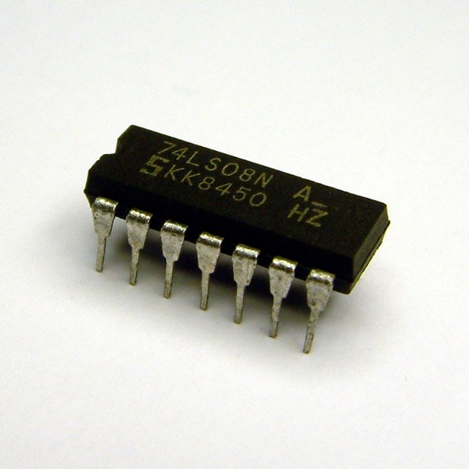
Gates
Example of AND gate circuit and packaging
http://www.electronics-tutorials.ws/logic/logic_2.html
http://hyperphysics.phy-astr.gsu.edu/hbase/electronic/diodgate.html
http://robokart.com/ic-s/7408-quad-and-gate.html
Notes:
The diagram on the right reflect how the gates are shown in microprocessor diagram.
Inside this chip, it’s a pre-packaged with 4 AND gates and each of these AND gate have 2 inputs connected to 1 output

Slide 30
Functionally Complete Set
Not all gate types used in implementation
Design and fabrication are simpler if only one or two types of gates are used
Any Boolean function can be implemented using only the gates in the set
The following are functionally complete sets
AND, OR, NOT
AND, NOT
OR, NOT
NAND
NOR
Notes:
Another concept I want to introduce here is the functionally complete set of gates
It is convenience to use all the different gates when we want to design the circuit
But in reality, not all gates are used in implementing logic circuit.
For example, if we want to produce a microprocessor, we want to embed a lot of gates inside, but it only make sense to use minimum number of gates because it is simpler to manufacture
AND, OR, and NOT gates constitute a functionally complete set, because they represent the three operations of Boolean algebra.
For the AND and NOT gates to form a functionally complete set, there must be a way to synthesize the OR operation from the AND and NOT operations.

Slide 31
Functionally Complete Set
AND, OR, NOT
AND, NOT
OR, NOT
NAND
NOR
For AND and NOT we can synthesize OR using the DeMorgan’s theorem
Digital circuits frequently implemented using either NAND or NOR gates only
Notes:
AND, OR, and NOT gates constitute a functionally complete set, because they represent the three operations of Boolean algebra.
For the AND and NOT gates to form a functionally complete set, there must be a way to synthesize the OR operation from the AND and NOT operations.

Slide 32
A + B = A . B
A OR B = NOT ((NOT A) AND (NOT B))

Slide 33
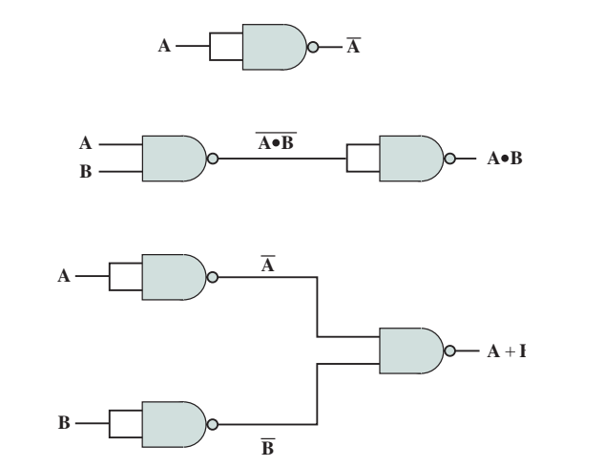
Implementation Using NAND
Notes:
Gate 1
A and A, by using NAND gate, you get Not A
Gate 2
A and B using NAND gate, you get Not A and Not B, but then, when you combine with another NAND gate, you get A and B

Slide 34
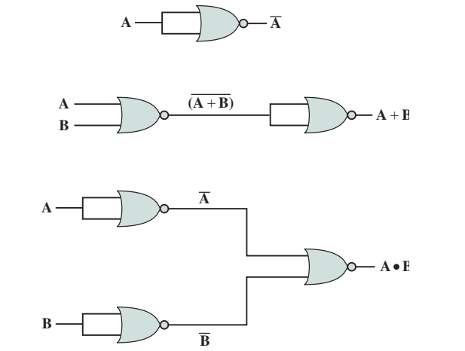
Implementation Using NOR

Slide 35
Write a function using the block diagram
A
B
F
C
x
x
y
F
y
F
x
x
y
y
a
b
F
a
b

Slide 36
Draw a block diagram based on the given function
F = AB + C
F = XY + X’Y + Y’Z
F = (A+B’)(A+B+C)(B’+C’)

Slide 37
Outline
Boolean Algebra
Gates
Combinational Circuits
Implementation of Boolean Functions
Multiplexers
Decoders
Read-Only Memory
Adders

Slide 38
Combinational Circuit
A combinational circuit is an interconnected set of gates whose output at any time is a function only of the input at that time.
As with a single gate, the appearance of the input is followed almost immediately by the appearance of the output, with only gate delays.
In general terms, a combinational circuit consists of n binary inputs and m binary outputs. As with a gate, a combinational circuit can be defined in three ways:
Truth table
For each of the 2n possible combination of input signals, the binary value of each of the m output signals is listed
Graphical symbols
The interconnected layout of gates
Boolean equations
Each output signal is expressed as Boolean function of its input signals
Notes:
A Boolean function can be achieved using a series of interconnected gates
Output is depending upon combination of input variables
Doesn’t use any memory

Slide 39
Implementation of Boolean Functions
Typically, there are several alternatives to express a function:
Sum of Product (SOP)
The output is 1 if ANY of the input combinations result in a 1 is true (1 term for each 1)
Any combination of variables produce result 1
Product of Sum (POS)
The output is 1 if NONE of the input combinations that produces 0 is true (1 term for each 0)
Any combination of variables produce result 0
( . ) + ( . ) + ( . ) …..
( + ).( + ).( + ) …..
Notes:
Product = AND
Sum = OR

Slide 40
Example of SOP
SOP
(X . Y . Z) = X + Y + Z
F = (ABC) . (ABC) . (ABC) . (ABC) . (ABC)
Itemising combinations of values of A, B, and C that cause F to be 1

Slide 41
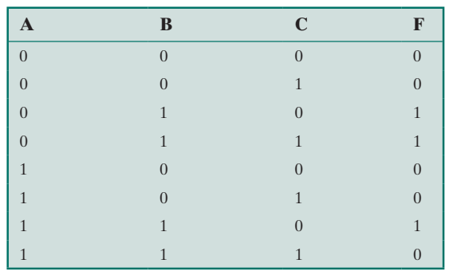
Implementation of Boolean Functions
SOP

Slide 42
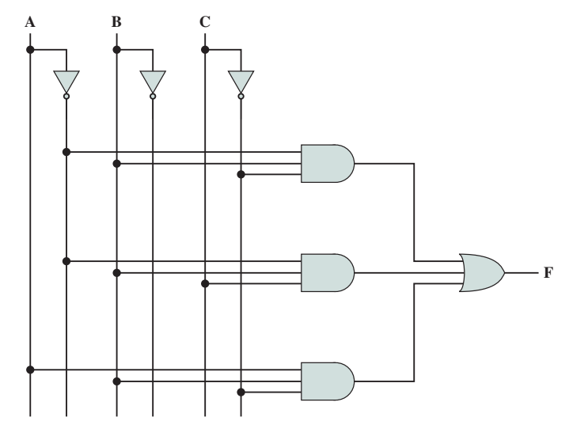
Sum of Product (SOP)

Slide 43

Example of POS
POS
F = (ABC) . (ABC) . (ABC) . (ABC) . (ABC)
(X . Y . Z) = X + Y + Z

Slide 44
Implementation of Boolean Functions
POS
F = (ABC) + (ABC) + (ABC) + (ABC) + (ABC)
Itemising combinations of values of A, B, and C that ensure NONE of the input combinations that produces 0 is true

Slide 45
Product of Sums (POS)
From DeMorgan’s theorem
DM1
DM2
(X + Y + Z) = X ⋅ Y ⋅ Z
(X ⋅ Y ⋅ Z) = X + Y + Z
Rewrite
F = (ABC) + (ABC) + (ABC) + (ABC) + (ABC)
F = (ABC) + (ABC) + (ABC) + (ABC) + (ABC)
DM1
F = (ABC) ⋅ (ABC) ⋅ (ABC) ⋅ (ABC) ⋅ (ABC)
F = (A+B+C) ⋅ (A+B+C) ⋅ (A+B+C) ⋅ (A+B+C) ⋅ (A+B+C)
DM2
= (A+B+C) ⋅ (A+B+C) ⋅ (A+B+C) ⋅ (A+B+C) ⋅ (A+B+C)

Slide 46
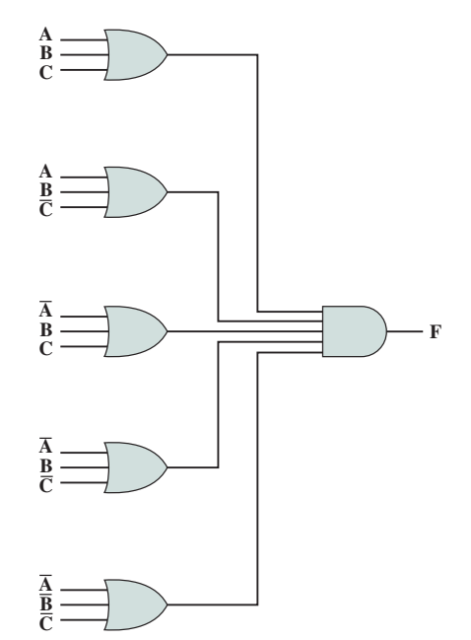
Product of Sums (POS)
F = (A+B+C) ⋅ (A+B+C) ⋅ (A+B+C) ⋅ (A+B+C) ⋅ (A+B+C)

Slide 47
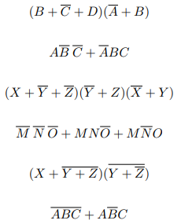
Quick Activity #1
Inspect each of these Boolean expressions, and determine whether each one is a sum of products (SOP) , or a product of sums (POS)
Notes:
POS SOP
POS
SOP
POS
SOP

Slide 48
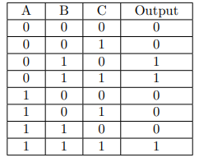
Quick Activity #2
Write an SOP and POS expression for this truth table:

Slide 49
SOP
F = ABC + ABC + ABC

Slide 50
POS
F = ABC + ABC + ABC + ABC + ABC

Slide 51
F = ABC + ABC + ABC + ABC + ABC
F = ABC + ABC + ABC + ABC + ABC
F =(ABC) . (ABC) . (ABC). (ABC) . (ABC)
F =(A+B+C) . (A+B+C) . (A+B+C). (A+B+C) . (A+B+C)
F =(A+B+C) . (A+B+C) . (A+B+C). (A+B+C) . (A+B+C)

Slide 52
Sum of Products vs Product of Sums
A Boolean function can be realized in either SOP or POS form.
At this point, it would seem that the choice would depend on whether the truth table contains more 1s or 0s for the output function:
The SOP has one term for each 1, and the POS has one term for each 0. However, there are other considerations:
It is often possible to derive a simpler Boolean expression from the truth table than either SOP or POS.
It may be preferable to implement the function with a single gate type (NAND or NOR)

Slide 53
Sum of Products vs Product of Sums
The significance of the first point is that, with a simpler Boolean expression, fewer gates will be needed to implement the function.
Three methods that can be used to achieve simplification are
Algebraic simplification
Quine-McCluskey Tables
Karnaugh maps

Slide 54



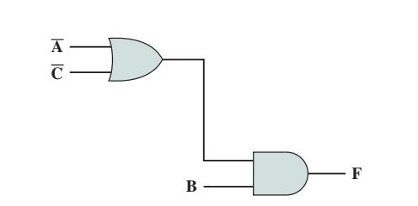
Algebraic simplification
Notes:
When we do simplification, we are basically reducing the use of gates
When we talk about the algebraic simplification, it is basically how we use the various Boolean identities that we discussed in previous class. The aim is to make the function simpler.
The simplification of Boolean algebraic is up to our creativity in terms of how we make use of those Boolean identities

Slide 55
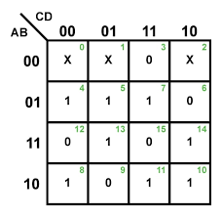
Karnaugh maps

Slide 56
Karnaugh Maps
For purposes of simplification, the Karnaugh map is a convenient way of representing a Boolean function of a small number (up to four) of variables.
The map is an array of 2^{n} squares, representing all possible combinations of values of n binary variables.
It is essential for later purposes to list the combinations in the order 00, 01, 11, 10.
Because the squares corresponding to the combinations are to be used for recording information, the combinations are customarily written above the squares.
Notes:
A Karnaugh Map is a graphical method of simplifying Boolean algebra expressions. It provides a systematic way to minimize Boolean functions, reducing complex logical expressions to their simplest form.
Squares or grid
00, 01, 11 and 10 – each representing different variables
One part of the K-map will represent A and B, the other part of K-map will represent C and D
Remember, when you do the labelling for K-map, you are not labelling it based on numerical sequence, rather than you follow the specific sequence of labelling of K-map

Slide 57
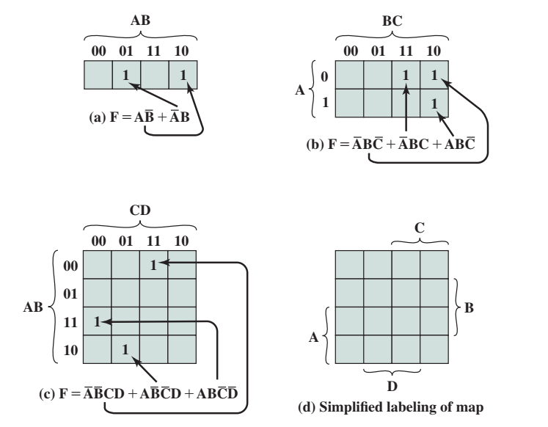
Karnaugh Maps
3 variables
2 variables
List of combination in order of 00, 01, 11, 10
Differ in one digit when side-by-side
Each square corresponds to unique product in SOP form
A 1 corresponding to the variable and a 0 to the NOT of that variable
4 variables
Notes:
Every terms from the Boolean algebraic is represented by 1 s

Slide 58
Constructing Karnaugh Maps
To construct based on truth table
Easy
Fill in corresponding square if result is a 1
2 variables = 4 squares
3 variables = 8 squares
4 variables = 16 squares

Slide 59
Constructing Karnaugh Maps
To construct from a Boolean expression
Need it in canonical form
Each term must contain each variable
we must first expand it into the full form of Equation
Then convert to the map
**Canonical form = writing the expression in a standard way (specifically Sum of Products or Product of Sums)

Slide 60
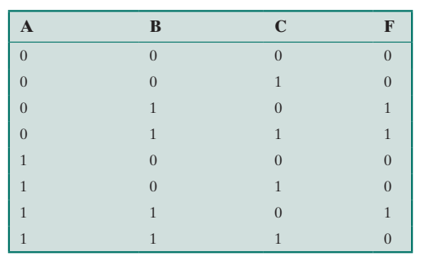
2
= AB (C + C) + BC (A + A)
= AB (1) + BC (1)
1
2
= AB + BC
1

Slide 61
BC
 | 00 | 01 | 11 | 10
0 |  |  | 1 | 1
1 |  |  |  | 1
A
Notes:
The grouping of K-map is depends on how you want to map it
It can be AB at one side and C in one side, or A alone and BC as one group

Slide 62
C
 | 0 | 1
00
01 | 1 | 1
11 | 1
10
AB
Notes:
The grouping of K-map is depends on how you want to map it
It can be AB at one side and C in one side, or A alone and BC as one group

Slide 63
F = AB + AB
A | B | F
0 | 0 | 0
0 | 1 | 1
1 | 0 | 1
1 | 1 | 1
(A)
(B)
(A)
(B)
AB
00 | 01 | 11 | 10
 | 1 |  | 1

Slide 64
F = ABCD + ABCD + ABCD
0011
1001
1100
CD
 | 00 | 01 | 11 | 10
00 |  |  | 1
01
11 | 1
10 |  | 1
AB

Slide 65
CD
 | 00 | 01 | 11 | 10
00 |  |  | C | C
01 |  |  |  | B
11 | A |  |  | B
10 | A | D | D
AB
A simplified table to show the true value for A, B, C and D

Slide 66
Use of Karnaugh Maps
Algebraic expression can be simplified by noting the arrangement of 1s on the map
Principle
Any two squares that are adjacent differ by only one variable
If 2 adjacent squares both have an entry of 1, the 2 terms can be merged by eliminating that variable
Squares at the edge can be wrapped around
Notes:
If 2 terms are side by side, you can remove one variable

Slide 67
Use of Karnaugh Maps
C
B
A
1
1
B
D
D
ABCD + ABCD = ABD
0101
0111
C
=ABD (C + C)
=ABD (1)
=ABD
Notes:
This is 4 variables K-map with 2 terms
These 2 terms are side by side
If you have done it in the Boolean algebra way, we can eliminate the C variable
In K-map, we know that for 2 terms side by side, we can remove 1 variable
How do we interpret it in K-map way?
Okay, what is true for that grouping?
It is fully in NOT A, it if also fully in B and it is fully in D
However, it is partially in C and NOT C – its contradicting each other, so they cannot be in the simplified term

Slide 68
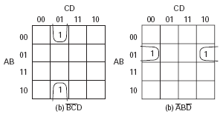
Use of Karnaugh Maps
When wrapped around the edges
C
1
B
A
1
B
D
D
ABCD + ABCD = BCD
0001
1001
A
Notes:
This one explain the wrap around (can be horizontally or vertically)
Firstly, we plot the K-map based on the SOP canonical form
Then, we look at true value of the grouping
It is partly in NOT A and A, then, it is fully in NOT C, NOT B and D
So, we can remove A because A and NOT A are contradicting each other

Slide 69

Use of Karnaugh Maps
When wrapped around the edges
C
B
A
1
1
B
D
D
ABCD + ABCD = ABD
0100
0110
C

Slide 70

Use of Karnaugh Maps
C
B
A
2^{n} adjacent squares can be groups (2, 4, 8, etc.)
Grouping of 4 squares eliminate 2 variables, with 8 – 3 variables
B
D
D
2 variables side by side – we drop 1 variables
4 variables side by side – we drop 2 variables
8 variables side by side – we drop 3 variables
16 variables side by side – we drop all 4 variables
Notes:
2 variables side by side – we drop 1 variables
4 variables side by side – we drop 2 variables
8 variables side by side – we drop 3 variables
16 variables side by side – we drop all 4 variables

Slide 71
Use of Karnaugh Maps
C
B
A
B
D
D
2 variables side by side – we drop 1 variables
4 variables side by side – we drop 2 variables
8 variables side by side – we drop 3 variables
16 variables side by side – we drop all 4 variables

Slide 72
Rules for Simplification
For squares with 1s, look for largest block of 2, 4 or 8 variables and circle.
Select additional blocks of marked square as large as possible and as few in number as possible. Include every marked square at least once.
Continue to draw loops around single marked squares, or pairs, or block of fours, eights to include all marked squares.
If any of isolated 1s remain after the groupings, group each of these individually
Any group that is completely overlapped by other group can be eliminated
Notes:
72

Slide 73
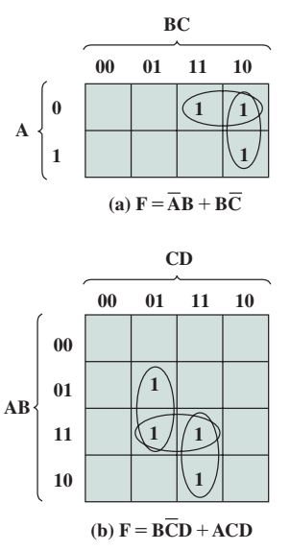
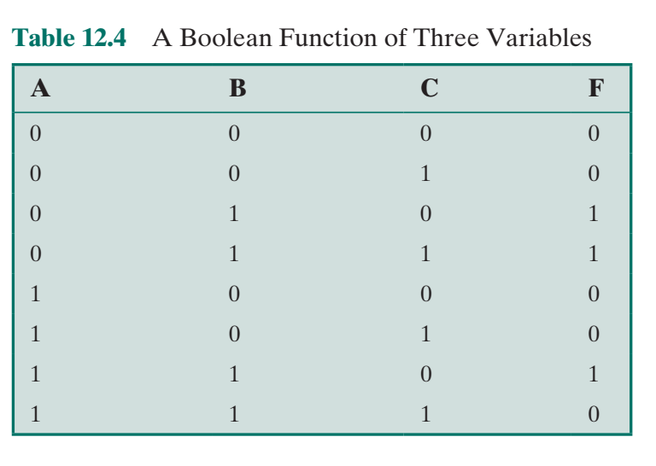
Rules for Simplification
C
B
A
Overlapping
B
D
D
Overlap in one cell
Eliminated
Notes:
For the second case, the overlapping happens in 2 cells and if you notice both overlapping, the cell already being taken care by other group, therefore, we can eliminate the overlapping so that we can have simplified terms for our Boolean expression

Slide 74
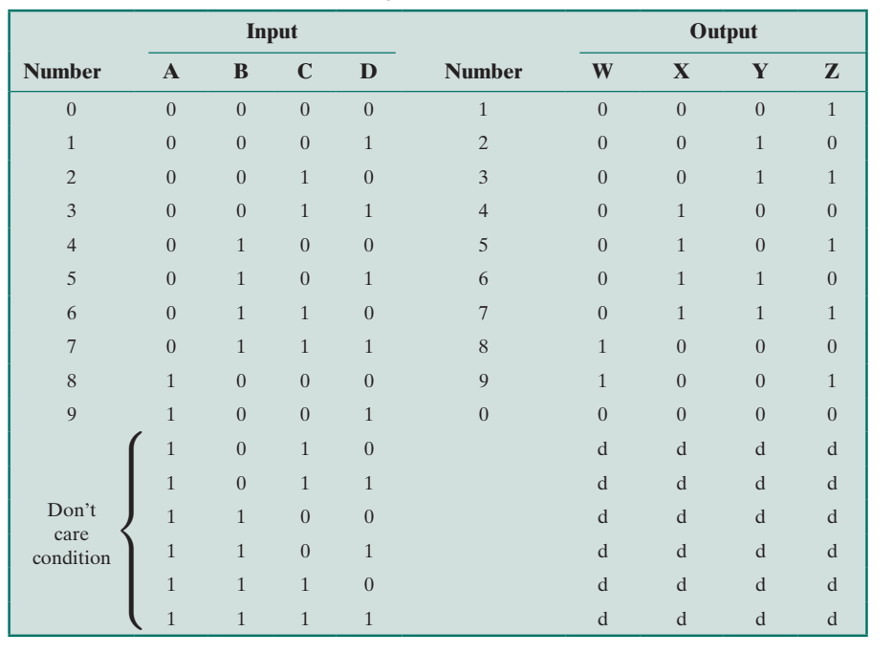
Rules for Simplification
“Don’t care” condition marked as “d”
Certain combinations of values never occur, hence corresponding output never occur. It simplifies the expression since the value can be either 1 or 0
E.g. incrementer
in packed decimal
Don’t care cannot form their own group
Notes:
There are also situation whereby the output or the function does not have the clear true or false value.
One of the example is packed decimal representation.
Let say you want to represent 0 to 9, so you need 10 patterns to represent 0 – 9. In order to represent 10 patterns, you need at least 4 bits. 3 bits isn’t enough because you can only represent 0 to 7. So you need at least 4 bits. But if you are given 4 bits, you can represent up to 15, so you can basically using 4 bits to represent up to 16 patterns
But, you only need to represent 0 to 9, so from 10 to 15 will be extra patterns that you don’t need
You can include don’t care value in your grouping but you only use don’t care value if they can help another valid terms….

Slide 75
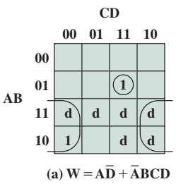
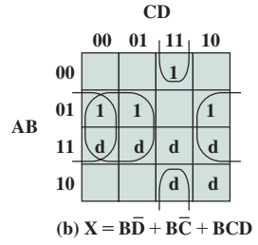
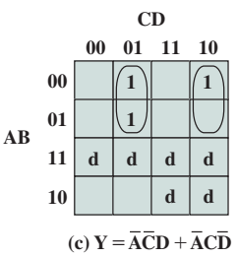
Example

Slide 76
Use Karnaugh map to simplify
F = ABCD + ABCD + ABCD + ABCD
0101
0111
11101
1111
C
C
 | 00 | 01 | 11 | 10
00
01
11
10
B
A
1
1
F = BD
B
1
1
A
B
D
D
D

Slide 77
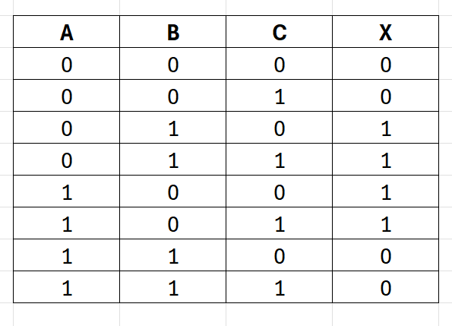

Slide 78
3 variables = 8 square
Labelling sequence = 00 01 11 10
Variable Labelling = A / BC
BC
00
01
11
10
0
A
1

Slide 79
A’BC’ + A’BC + AB’C’ + AB’C
010 + 011 + 100 + 101
BC
00
01
11
10
0
1
1
A
1
1
1
Group 1
A’B
F = A’B + AB’
Group 2
AB’

Slide 80
A’BC’ + A’BC + AB’C’ + AB’C
010 + 011 + 100 + 101
C
0
1
00
Group 1
A’B
01
1
1
AB
11
Group 2
AB’
10
1
1
F = A’B + AB’

Slide 81
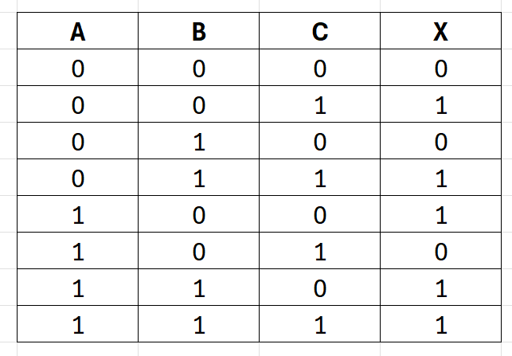

Slide 82
A’B’C + A’BC + AB’C’ + ABC’ + ABC
001 + 011 + 100 + 110 + 111
C
0
1
Group 2
A’C
00
1
01
1
AB
11
1
1
Group 3
AB
Group 1
AC’
10
1
F = AC’ + A’C + AB

Slide 83
A’B’C + A’BC + AB’C’ + ABC’ + ABC
001 + 011 + 100 + 110 + 111
Group 1
A’C
Group 4
Overlapping
BC
BC
00
01
11
10
Group 2
AB
1
1
0
A
Group 3
(wrap around)
AC’
1
1
1
1
F = A’C + AB + AC’

Slide 84
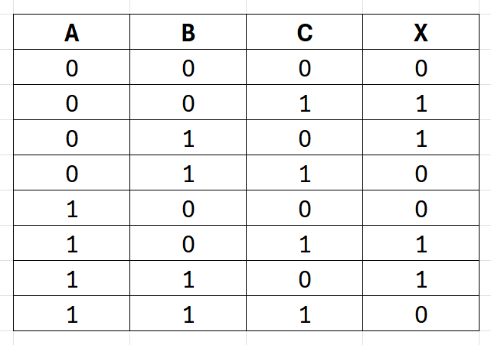

Slide 85
A’B’C + A’BC’ + AB’C + ABC’
001 + 010 + 101 + 110
Group 1
B’C
BC
Group 2
BC’
00
01
11
10
1
1
0
A
1
1
1
F =B’C + BC’

Slide 86
A’B’C + A’BC’ + AB’C + ABC’
001 + 010 + 101 + 110
Group 1
BC’
C
0
1
Group 2
B’C
00
1
01
1
AB
11
1
10
1
F =BC’ + B’C

Slide 87
Quick Activity #3
Simplify the following Boolean expression using the Karnaugh Maps method:
A’B’C’ + A’B’C + AB’C’ + AB’C
A’B’C + A’BC’ + ABC’ + AB’C’

Slide 88
A’B’C’ + A’B’C + AB’C’ + AB’C
000 + 001 + 100 + 101
BC
00
01
11
10
0
1
1
A
1
1
1
F = B’

Slide 89
A’B’C’ + A’B’C + AB’C’ + AB’C
000 + 001 + 100 + 101
C
0
1
00
1
1
01
AB
11
10
1
1
F =B’

Slide 90
A’B’C + A’BC’ + ABC’ + AB’C’
001 + 010 + 110 + 100
Group 3
A’B’C
BC
Group 1
BC’
00
01
11
10
0
1
1
A
1
1
1
Group 2
Wrap-around
AC’
F =BC’ + AC’ + A’B’C

Slide 91
A’B’C + A’BC’ + ABC’ + AB’C’
001 + 010 + 110 + 100
C
Group 3
A’B’C
0
1
Group 1
BC’
00
1
01
1
Group 2
AC’
AB
11
1
10
1
F =BC’ + AC’ + A’B’C

Slide 92
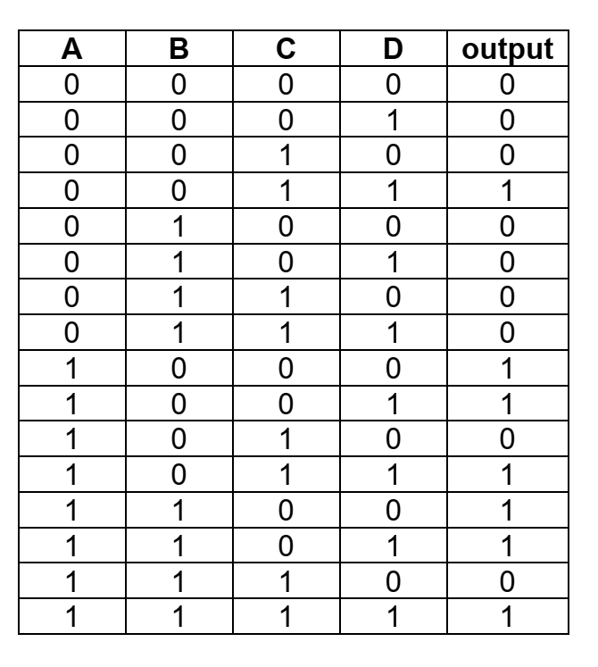

Slide 93
A’B’CD + AB’C’D’ + AB’C’D + AB’CD + ABC’D’ + ABC’D + ABCD
0011 + 1000 + 1001 + 1011 + 1100 + 1101 + 1111
C
F = AC’ + AD + B’CD
00
01
11
10
1
00
01
B
11
1
1
1
A
10
1
1
1
D

Slide 94
Karnaugh Map
Karnaugh map > 4 variables gets cumbersome
5 variables: two 16 x 16 maps with one map on top of each other in 3D
6 variables: 4D

Slide 95
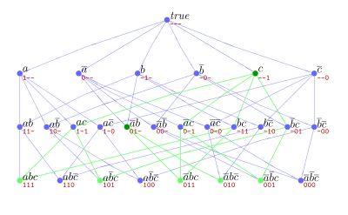
Quine-McKluskey Method

Slide 96
Quine-McKluskey Method
Quine-McKluskey method suitable for programming
The basic principle is the same, i.e. eliminating variables that complement each other
Notes:
Not rely on visualising a map, it is algorithmic in nature because you have to follow certain steps or certain cycle to follow.
It works for cases with more than 4 variables.

Slide 97
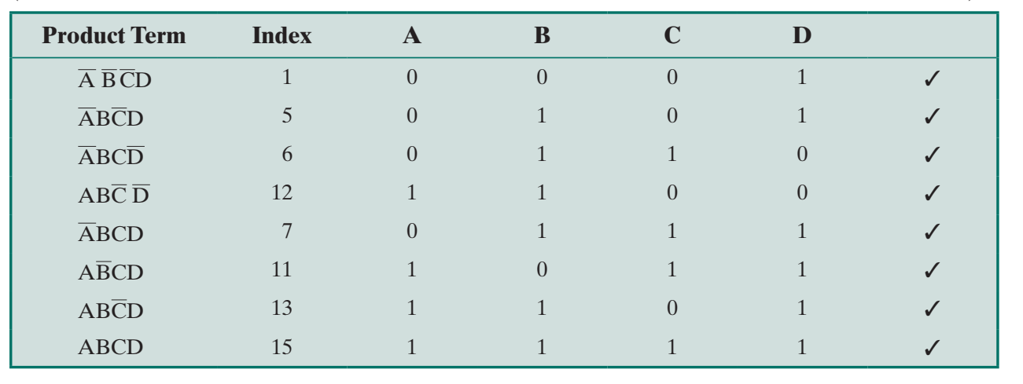
Quine-McKluskey Method
Construct table in which each row corresponds to one of the product terms
Terms are grouped according to number of complemented variables
1. List the term based on the number of NOT (Larger to smaller)
G1
G2
G3
G4
Notes:
Let’s look at this example. The function has 8 terms.
You must generate a table and then on the most left column, you will list all the terms that are available in the function.
Take note that you must list the term based on the number of NOT. From larger to smaller.
The first group has 3 NOT, and the second with 2 NOT. What is the difference? They differ in 1 variable.
You can see the pattern. Group 2 and Group 3, they differ in 1 variable….therefore, there is an opportunity to eliminate the variable as we go along

Slide 98

Quine-McKluskey Method
Next step to find all pairs of terms that differ in only one variable
Start with first group and comparing each term of first group with every term of second group
We compare group 1 and 2, 2 and 3 & 3 and 4.
ABCD
ABCD
ABCD
ABCD
ABCD
ABCD
Notes:
The sorting of product term with different NOT value already help, so you just have to find all pairs of terms that different in only one variable.
Don’t bother to compare between group 1 and 4 because they differ in 3 variable…we are looking at 1 variable different
By completing this step (By each of those pairs). We now have already identified which variables that are causing them to be different.

Slide 99
Quine-McKluskey Method
ACD
BCD
BCD
ABD
ACD
ABC
ABD
ABC
Notes:
The sorting of product term with different NOT value already help, so you just have to find all pairs of terms that different in only one variable.
Don’t bother to compare between group 1 and 4 because they differ in 3 variable…we are looking at 1 variable different
By completing this step (By each of those pairs). We now have already identified which variables that are causing them to be different.

Slide 100
Quine-McKluskey Method
BCD
ABCD
ABCD
A and Not A – differ in 1 variable
ABD
ABCD
ABCD
Not C and C – differ in 1 variable
ABC
ABCD
ABCD
Not D and D – differ in 1 variable
ABC
ABCD
ABCD
Not D and D – differ in 1 variable
Notes:
The sorting of product term with different NOT value already help, so you just have to find all pairs of terms that different in only one variable.
Don’t bother to compare between group 1 and 4 because they differ in 3 variable…we are looking at 1 variable different
By completing this step (By each of those pairs). We now have already identified which variables that are causing them to be different.

Slide 101
Quine-McKluskey Method
New table also organised into groups
Processed in the same way as first table where you will find the different pairs term
ACD
BCD
BCD
ABD
ACD
BD
ABC
ABD
ABC
The third table contains only one term: BD
Notes:
Look at these 3 groups, they are differing by 1 variable from group to group
Group 1 and group 2, no pairing, so no changes
Group 2 and group 3, there are 2 pairing

Slide 102
Quine-McKluskey Method
Terms that have not been eliminated are used to construct a matrix
Row: term that have not been eliminated
Column: Term in original expression
X: row and column “compatible”
X : X that is alone in column
X : X in any row with a X
If every column has either X or X , then done
Row elements whose Xs have been marked constitute the minimal expression

Slide 103
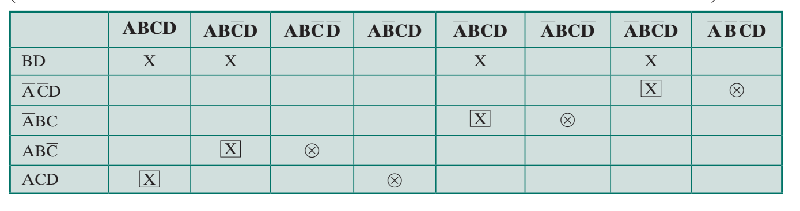
Quine-McKluskey Method
ACD
BCD
BCD
ABD
ACD
BD
ABC
ABD
ABC

Slide 104
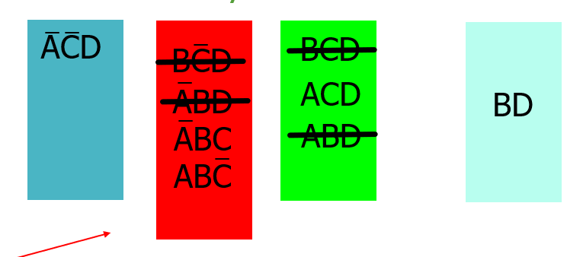
Terms that have not been eliminated are used to construct a matrix
Row: term that have not been eliminated
Column: Term in original expression
X: row and column “compatible”
X : X that is alone in column
X : X in any row with a X
If every column has either X or X , then done
Row elements whose Xs have been marked constitute the minimal expression
ACD + ABC + ABC + ACD

Slide 105
Use Quine-McKluskey Method to simplify
F = ABCD + ABCD + ABCD + ABCD
A
B
C
D
ABCD
0
1
0
1
ABCD
0
1
1
1
ABCD
1
1
0
1
ABCD
1
1
1
1

Slide 106
F = ABCD + ABCD + ABCD + ABCD
ABD
BCD
BD
BCD
ABD
ABD
BCD
BD
BCD
ABD

Slide 107




F = ABCD + ABCD + ABCD + ABCD
BD
X
X
X
X
F = BD

Slide 108
Quick Activity #4
Discuss the difference between Karnaugh map and Quine McCluskey methods.
Next, simplify the following Boolean expression using both Karnaugh map and Quine McCluskey method
ABCD + ABCD + ABCD + ABCD + ABCD + ABCD

Slide 109
NAND and NOR Implementations
Another consideration in the implementation of Boolean functions concerns the types of gates used.
It is sometimes desirable to implement a Boolean function solely with NAND gates or solely with NOR gates.
Although this may not be the minimum-gate implementation, it has the advantage of regularity, which can simplify the manufacturing process.
Notes:
In any implementation of Boolean, logic, designers who wants to try as far as possible to use only 1 kind of gate

Slide 110




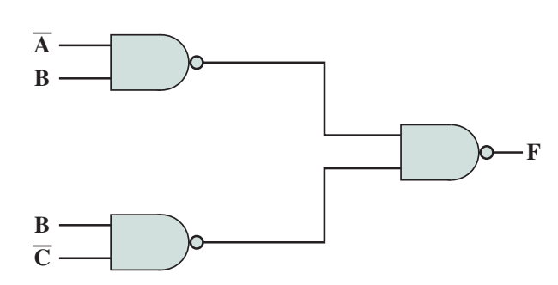
NAND and NOR Implementations
Apply DeMorgan’s theorem
Notes:
Use the Boolean law, in this case, the DeMorgan Theorem is used to convert the expression by using only 1 gate

Slide 111
Outline
Boolean Algebra
Gates
Combinational Circuits
Implementation of Boolean Functions
Multiplexers
Decoders
Read-Only Memory
Adders
Notes:
We will proceed with combinational circuits….Multiplexers, decoders, ROM and adders are still part of combinational circuits…..
It means we put the gates together in order to perform particular functions, like how we express Boolean algebra, or computer operation like selection, decoding, it can be done with combinational circuit or logic gate

Slide 112
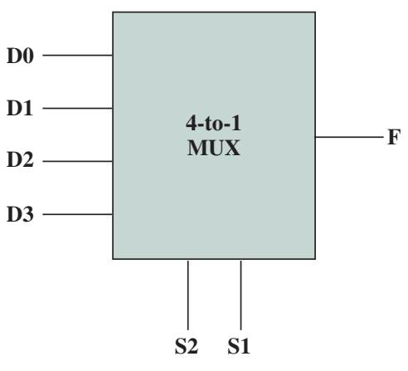
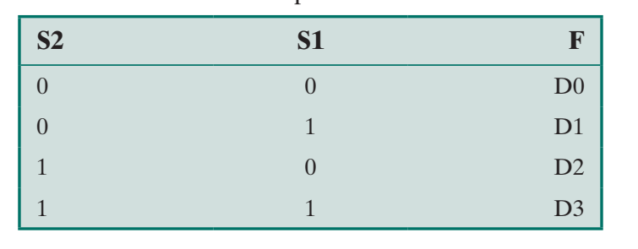
Multiplexers
The multiplexer connects multiple inputs to a single output.
At any time, one of the inputs is selected to be passed to the output.
One of inputs is selected to be passed to output
An example of 4-to-1 multiplexer
4 inputs (DO, D1, D2, D3)
2 selector lines (S1, S2)
Notes:
Multiplexer is a combinational circuit that perform something….what does it perform?
It connects multiple inputs and look at the schema, it is very often to label it as MUX
Multiple input on the left side, from D0 to D3.
Out of these 4 inputs, only 1 will be selected to go through the output.
How do we select which input will go thru the output? We have these 2 selectors here
For example, based on this example, if you want D0 to be selected, you must make sure Selector 1 and Selector are both 0. So, whatever input value from D0 will be channelled to F.

Slide 113
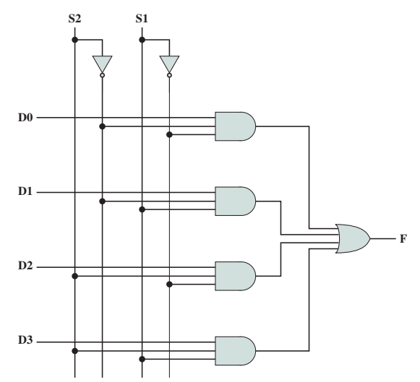
Multiplexers
Implementation using AND, OR, and NOT gates
For any combination of the inputs, three AND gates will result in a zero, the fourth will output the value of the selected lines (either 0 or 1)
This can extend to MUX 8-to-1, 16-to-1
Notes:
In terms of implementation, multiplexer will use AND, OR and NOT gates
The good thing about Multiplexer, only 1 AND gate will be ready to channel the value, (True value), so the other 3 AND gates will be a false (0 value).

Slide 114
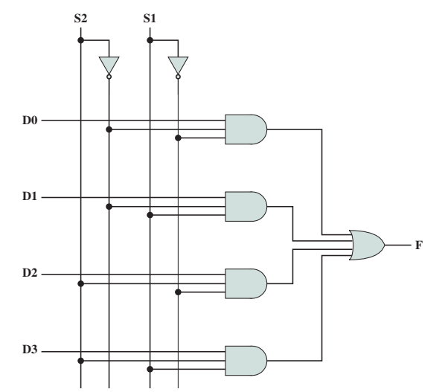
0
0
1
1
1
1
1
1
1
x
1
1
0
0
x
0
0
1
1
x
0
0
0
0

Slide 115
0
1
1
x
1
1
0
1
1
1
1
1
1
1
x
0
0
0
0
x
0
0
0
0

Slide 116
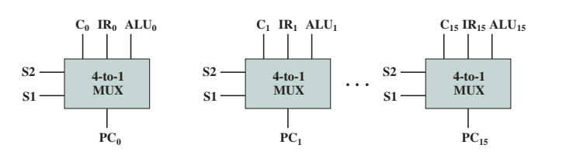
Multiplexers
Used to control signal and data routing
Example: address to be loaded in the Program Counter may come from different sources:
a binary counter if the PC is to be incremented for the next instruction
instruction register (direct branch) if a branch instruction using a direct address has just been executed
output of the ALU (indirect branching) if the branch instruction specifies the address using a displacement mode.
Notes:
What is the function of multiplexer?
Because of the selection nature of the multiplexer, it can be used for the routing.
Meaning, there are many possible inputs, but hey, I want you to be routed to the output.
It performs a routing kind of function.
If you notice in the previous example of multiplexer, it only handle 1 bit, therefore, if the instructions comes in in 16 bit, each bit need to have its own multiplexer
Therefore, all multiplexer will only handle 1 bit only.
Based on the diagram on the screen, the most left MUX handle the first bit and the rightest MUX handle the 16th bit.

Slide 117
Multiplexers
0 1
C
15
0 1
IR
15
0 1
ALU
15
0 1
15
PC
Notes:
From this example, let say we want to choose address from the binary counter, so we want to choose the address from C to go thru the program counter, so we set S1 and S2 to 00, and this 00 must be consistently be used for the MUX. And that is why, you see that the selectors are connected in Parallel to all MUX.

Slide 118
Multiplexers
00
0 1
C
15
0 1
IR
15
0 1
ALU
15
0
0
0
0
0
0
0 1
15
PC
Notes:
Look at this example, every bit of the binary counter will then be selected to go to each bit of the MUX.

Slide 119
Multiplexers
01
0 1
C
15
0 1
IR
15
0 1
ALU
15
1
1
1
0
0
0
0 1
15
PC

Slide 120
Multiplexers
10
0 1
C
15
0 1
IR
15
0 1
ALU
15
0
0
0
1
1
1
0 1
15
PC

Slide 121
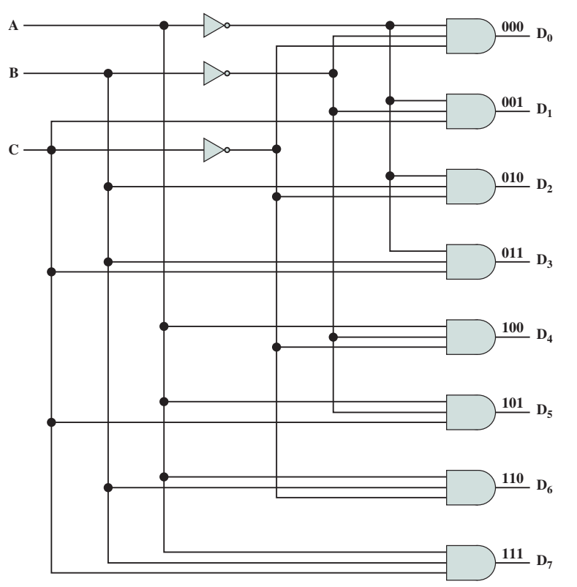
Decoders
A combinational circuit with a number of output lines
Only one asserted at any one time
Depends on pattern of input lines
n input lines to a maximum of 2^{n} output lines
E.g. 3 inputs, 8 outputs
Notes:
The decoders considered certain pattern, for example, here we have 3 inputs, it will decide 2n of output will be chosen.

Slide 122
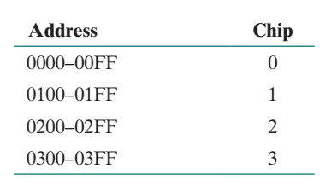
Decoders
Decoders find many uses in digital computers.
Example: address decoding
Build a 1K-byte memory using four 256 x 8-bit RAM chips
A single unified address space can be broken down as follows:
8 bit
1K
256
0 - 255
256
256 - 511
512 - 767
256
768 - 1024
256
Notes:
Imagine that you have a memory chips, okay based on the given information in slides, you have a 1 kilo byte of memory
1 byte – 8 bit
Therefore, if you have 1k byte memory, you can imagine they are 1000 locations that are 8 bits long
It means, you can implement with 4 x 256 bit chips
Binary kilo = 1024 == 2¹⁰
F = 255 in hexadecimal

Slide 123
Decoders
Example: address decoding
Each chip requires 8 address lines (to choose one of the 2⁸ = 256 words
Higher-order 2 bits used to select one of the four RAM chips
2-to-4 decoder needed
Total 8+2=10 bits needed to address 1KB
8 bits – to address each location in the chips
2 bits – to use to select which chips will be utilized
Notes:
Okay, another piece of information, every chip need 8 address line. WHY ?
Imagine your desasiswa, you 10 building of desasiwa but you only reserve 1 digit to represent the addresses? Enough or not? At least you need 2 digits to address the location of each unit within each desasiswa building
In the case of 256 location, you need the necessary number of bits to address all the 256 location. That is why you need 8 address lines to choose one of the 256 locations.
And now, it is 1K byte chips, so it has 1024 locations and it requires two to the power of 10 to make it 1024.
Therefore, for 1K byte chips, it requires 10 bits to represent the address, however, we only have 8 bits. So, where does the other 2 bits go?
So, in this case, you have another mechanism that can be used to choose 1 out of the four chips
And since you need to choose, one out of the four chips,

Slide 124
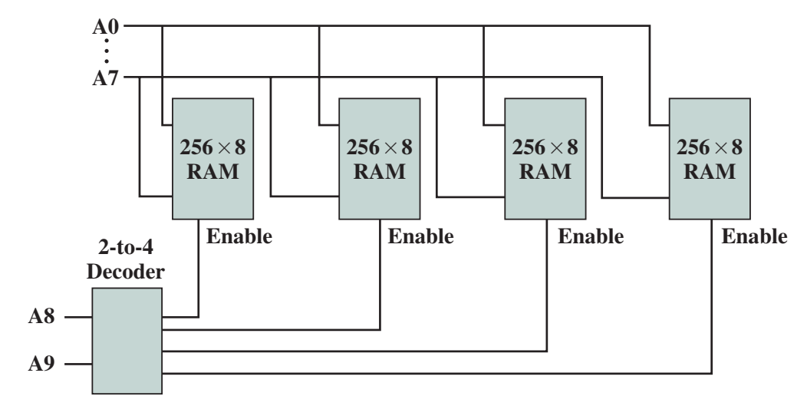
Decoders
8 bits
2 bits
Notes:
You can see that all chips are connected in parallel, therefore, let say if you want to choose the first location address, 00000000, so, all first address location of all chips will be chosen
And now, look at the decoder here, for this case, we are using 2-to-4 decoder, but please notice that we have different type of decoder, we have 1 to 2, 2 to 4 and 3 to 8, 4 to 16 and 5 to 32 decoder and so on and so forth
Look the decoder, we have 2 bits here, so if you want the first location to be chosen, so A8 and A9 will be 0 as well.
00
01
10
11
So, the first output will be chosen and the other location in other chips will not be chosen, in a simpler way to say this, the first address from the first chip will be chosen and turn on, the rest will be turned off.
That is how basically addressing of location is done using decoders

Slide 125

Time to think!
Notes:
I want you to think. What happens here?
You have 8 address line, what do you think the circuit will be look like in order to choose one of the 256 location?
Draw the decoder – left side 8 address line, right side, 256 location
So, what is the diagram is just draw? The decoder…in order for the 8 address line to choose the location, it needing the decoder as well

Slide 126
Decoders
With additional input line, a decoder can act as a demultiplexer
connects single input to one of several outputs
n inputs decoded to produce one of 2^{n} outputs
All 2^{n} outputs lines are ANDed with a data input line
Thus, the n inputs act as an address to select a particular output line, and the value on the data input line is routed to that output line
Multiplexer is many to one
Notes:
The demultiplexer can be implemented using the decoder, by introducing one additional input
Demultiplexer is the reverse of multiplexer – one to many

Slide 127
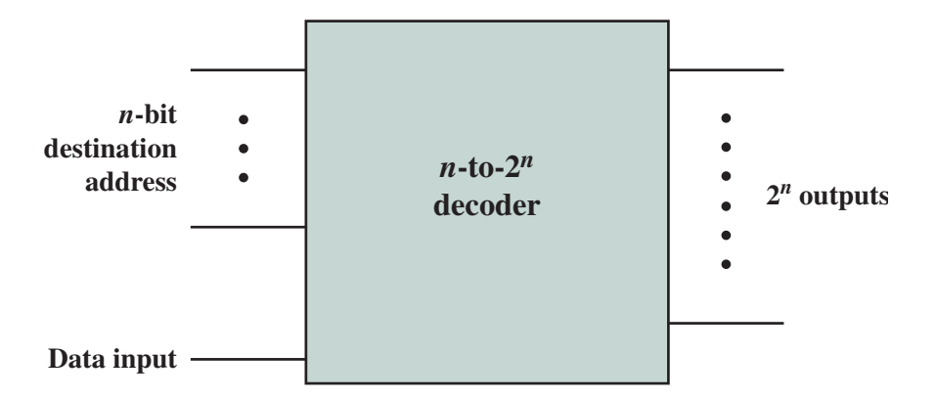
Decoders
Notes:
If you notice, I introduce another input line to the decoder and the others looks like a decoder
And below is the original MUX diagram….with this, I am channelling this input values to one out of 2 to the power of n outputs

Slide 128
Read-Only Memory (ROM)
Combinational circuits are often referred to as “memoryless” circuits, because their output depends only on their current input and no history of prior inputs is retained.
Combinational circuits do not have the capability to store information
Although memory requires “storing” capability, this is not true for ROM
128
Notes:
The other combinational circuit is Read only memory….
Why it is called ROM, it is because gates pattern and the truth table are fixed…it is different from the RAM because RAM changes overtime, but for ROM, it means the truth table is fixed,

Slide 129
Read-Only Memory (ROM)
ROM performs only read operation, the info in ROM is permanent with each address keeping the same input data. This is achieved by combinational circuit.
129

Slide 130
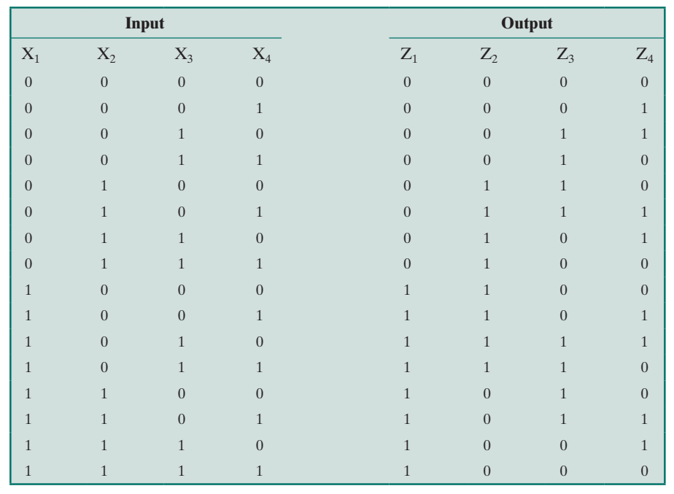
Read-Only Memory (ROM)
Can be implemented using a decoder and OR gates
E.g. truth table with 4 inputs and 4 outputs

Slide 131
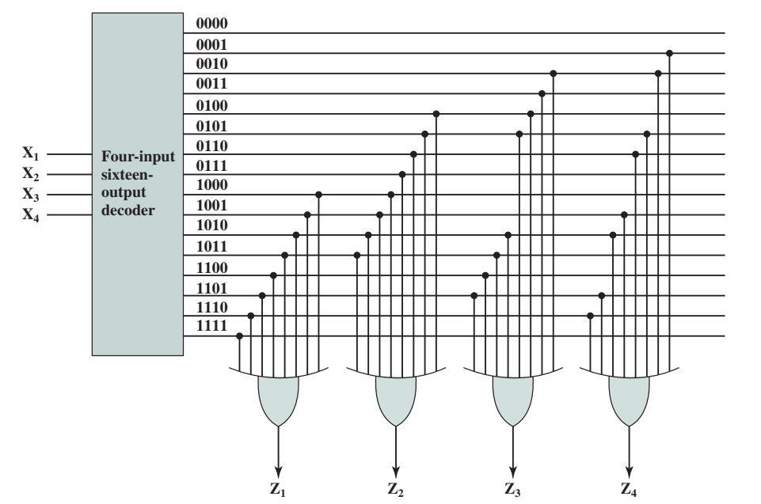
Read-Only Memory (ROM)
64-bit ROM with 16 words of 4 bits each
4 inputs specify and address
4 outputs specify the contents of the location
Notes:
This is the 64-bit ROM based on the previous truth table
Z1 to Z4 are the outputs,
If you notice ROM is the in the form of SOP because it uses the OR gates

Slide 132
Adders
So far, we have seen how gates implement functions to route signals, decode, and store
Gates can be used for arithmetic
Addition
A single bit addition: two 1-bit inputs, a sum with a carry bit
Notes:
Adders are also combinational circuit.
If you notice, when you do adding, there is a pattern to the adding.

Slide 133
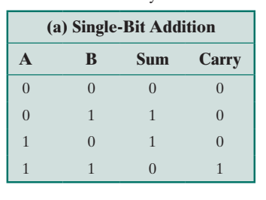
Adders
Logic for adding two input bits to produce 1-bit sum and a carry bit
Simple for single pair of bits
A
A
A
A
B
B
B
B
Carry 0
Sum
Carry 0
Sum
Carry 0
Sum
Carry
Sum
Notes:
Based on this truth table, A and B is the input and your sum and carry are a function

Slide 134
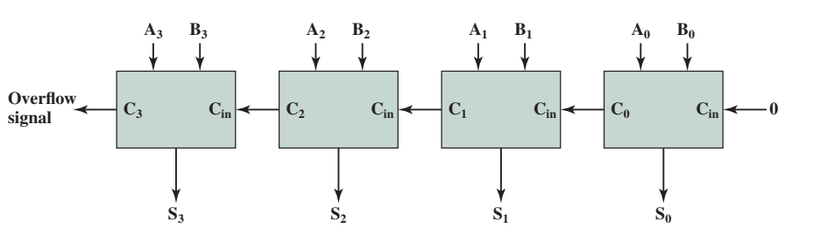
Adders
Adding two n-bit numbers require n sets adders
Carry from one adder is provided as input to the next adder
Each adder need 3 inputs
A carry from the lower-order adder apart from the 2 usual inputs
Notes:
What you just have seen is just 1 bit of addition, in reality, you will be working with larger number with wider bits, you can either work with 8 bits number, 16 bits numbers and so on
Therefore, to handle addition of larger number, you need a sequence of adder…which is many adder next to each other
If you notice is that, on your right side is the LSB… you will add A0 and B0 and the output is stored in S0 and with the carry bit….
Alright, for the next bit, you will now add A1 and B1 together with the carry bit from the previous operation and then the output will be stored in S1…same goes to A2 and B2, you will add these two inputs together with carry bit from previous operations

Slide 135

Adders
*
*
*
Sum = ABC + ABC + ABC + ABC
Carry = ABC + ABC + ABC + ABC
Carry = ABC + ABC + ABC + ABC
+ ABC + ABC
Carry = AB (C+C) + AC(B+B) + BC (A+A)
Carry = AB + AC + BC
Notes:
So, you will get this truth table with 3 inputs and 2 outputs
Okay now, based on this Boolean algebraic notation, the sum somehow cannot be simplified, but the carry can be simplified.
We then add ABC to the carry because logically, when A added B where both are 1, you get a carry, therefore, to help with the simplification, we added 2 ABC by using the logic of carry bit
The difference between the carry and sum function, the carry function can be simplified, but for sum, it rather not practical or complicated to be simplified
For carry, if you make comparison, there are certain terms that are differ in 1 variable, so we can duplicate ABC to assist carry in simplification

Slide 136


Slide 137
Adders
Sum = ABC + ABC + ABC + ABC
Carry = AB + AC + BC
Notes:
So for you 1 bit adder, the circuit will look like this
Inside the adder, you will produce a sum and you will produce a carry

Slide 138

Adders
Multiple-bit adder
Output of each adder depends on carry from previous adder
Increasing delay from least significant to most significant bit
Each single-bit adder has gate delay which accumulates
Delay can be high for very large adders
Notes:
So what happens if you have multiple adders? You basically combine adders in sequence, in this example you combine 8-bit adders to 4 to make it 32 bit adders. …
The main issue with this kind of adders is the propagation delay because of the carry…we will start on the LSB and you have to propagate the carry 8 times before you can pass it to the next adder and this slows down the operation
32 propagation of the carry

Slide 139
Adders
If carry could be determined without going through all the stages, each single-bit adder could function independently
Delay would not accumulate
Carry lookahead
In 4-bit adder:
C₀
C₂
C₀
C₀
C₁
C₁
A₀
B₀
S₀
A₂
B₂
S₂
A₀
B₀
S₀
A₀
B₀
S₀
A₁
B₁
S₁
A₁
B₁
S₁
C₀ = A₀B₀
C₁ = A₁B₁ + A₁A₀B₀ + B₁A₀B₀
C₀
C₀
C₁
C₁
C₁
C₁
C₁
C₁
C₂ = A₂B₂ + A₂A₁B₁ + A₂A₁A₀B₀ + A₂B₁A₀B₀ + B₂A₁B₁ + B₂A₁A₀B₀ + B₂B₁A₀B₀
Notes:
To solve this is to use the lookahead concept
We use 4 bit adder example, if I already have A n B value,
C0 value depends on A and B
Okay ,for 1 bit, If A0 and B0 is 1, C0 will be surely 1
For 2 bits,
- C1 value depends on A1 and B1 value, you can predict the C1 value, let say your A1 and B1 are both 1, so C1 will be true already
C1 don’t need to know C0, it just need to know the input of its group, in this case, A1 and B1,
In simpler ways to say it, for multiple adder, if you can know the value of input, A and B, you can already predict the carry

Slide 140

Reflection…
From the lecture today,
I learnt…
Link on eLearn / Chat
Image source: https://www.flickr.com/photos/29143375@N05/4582236533

